Slide 1

INSTITUTE - UIE
DEPARTMENT- ACADEMIC UNIT-2
Bachelor of Engineering (Computer Science & Engineering)
Subject Name: Introduction to Problem Solving
Code:22CSH-101
Data Types and Variables
DISCOVER . LEARN . EMPOWER

Slide 2
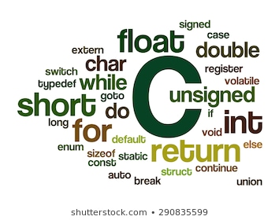
Introduction to Problem Solving
Course Objectives
The course aims to provide exposure to problem-solving through programming.
The course aims to raise the programming skills of students via logic building capability.
With knowledge of C programming language, students would be able to model real world problems.

Slide 3



Course Outcomes
CO Number | Course Outcome
CO1 | Remember the concepts related to fundamentals of C language, draw flowcharts and write algorithm/pseudocode.
CO2 | Understand the way of execution and debug programs in C language.
CO3 | Apply various constructs, loops, functions to solve mathematical and scientific problem.
CO4 | Analyze the dynamic behavior of memory by the use of pointers.
CO5 | Design and develop modular programs for real world problems using control structure and selection structure.

Slide 4
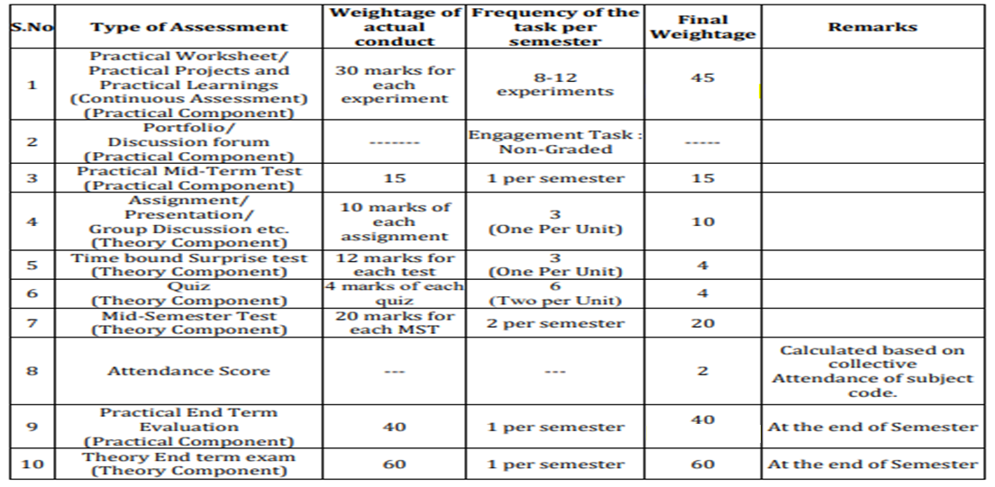
Scheme of Evaluation

Slide 5
Contents
C0NTENTS
Data Types
Variables
Constants

Slide 6
Data types
Data Types
Data type is used to specify the range of values that a particular variable can take during program execution
Each variable in C is associated with data type that determines memory space for its storage
Data type determines which type of value a particular variable can take

Slide 7
Data Types- Categories
Data types
Primary Data Types: These data types are predefined into C system Their storage space , range of values and format specifiers are all fixed
Derived Data Types : The data types which are derived from primary data types are called derived data types .
User Defined Data Types : These data type are defined by users according to their requirements with the combination of primary data types .

Slide 8
Data types

Slide 9
Data types Size Chart
Data Type | Memory Space | Range Of Values | Format Specifiers
Signed char | 1 Byte | -128 To +127 | %c
Unsigned char | 1 Byte | 0 To 255 | %c
signed int | 2 Bytes | -32768 to +32767 | %d
unsigned int | 2 Bytes | 0 to 65535 | %u
signed long | 4 Bytes | -2147483648 To 2147483647 | %ld
unsigned long | 4 Bytes | 0 To 4294967295 | %lu

Slide 10
Data types Size Chart
Data Type | Memory Space | Range Of Values | Format Specifiers
signed long long int | 8 Bytes | -9223372036854775808 To 9223372036854775807 | %lld
unsigned long long int | 8 Bytes | 0 To 18446744073709551615 | %llu
float | 4 Bytes | -3.4 E38 To +3.4E38 | %f
double | 8 Bytes | -1.7E308 To +1.7E308 | %lf

Slide 11
Data types
Steps to remember
1. The formula to calculate range is -2^{n-1} To 2^{n-1}-1 where n is the no. of bits taken by a particular data type.
2. Char takes one byte in memory in all C compilers .
3. The Ranges of data types are specified here according to 16-bit compiler .
4. Ranges for int and long data types are compiler dependent that will vary from 16 bit compiler to 64 bit compiler .

Slide 12
Constants
Constants
Constants are the quantities that do not change their value
during execution of the program .

Slide 13
Integer Constants
An integer constant is that which can be decimal , hexadecimal and octal constant . An Octal is preceded by O and hexadecimal is preceded by 0X and decimal by none .
321 // Valid decimal constant
O458 // Invalid octal as 8 is not a octal digit
OX234

Slide 14
Real Constants
These are known as real constants . These constants include decimal point to represent real values . Real constants can also be represented in exponential form which has
mantissa and exponents. Exponent can be represented with e or E .
3.142 // Valid real constant
341E-5 // valid real constant represents 341 X 10⁻⁵
123E // Invalid exponent part is missing

Slide 15
Character Constant
Character Constants
These constants are represented in ‘ ‘ as ‘a’ . Special characters are used in C language that are preceded by \ like ‘\t’ and ‘\n’ are characters which are used as tab and new line Characters
characters in C
‘a’ // valid character constant
‘5’ // digit can be represented in char form
‘&’ // special symbol can be represented as character constant
‘\t’ // Special Character represents tab
‘an’ // Invalid it should include only single char

Slide 16
String Constant
String Constants
Any group of characters enclosed within “ “ is known as string constant
“Happy” // Valid string Constant
“#876 Pahar ganj New Delhi” // Valid
“Happy //Valid, two parts of strings can be separated into two lines
Diwali”

Slide 17
How to Define Constants ?
In C ,constants can be defined by two ways
a) Using const keyword b) Through Macros using #define
a)Const keyword can be used to define constants as:
const double pi=3.142;
Now value of pi will remain 3.142 till end of the program and cannot be modified

Slide 18
How to Define Constants ?
Macro can be used to define constants as :
#define pi 3.142
each occurrence of pi within the program will be replaced by 3.142 and this value can
never get changed during execution of the program .

Slide 19
Variables
Variables
Variables are the quantities whose value changes during the execution of the program Variable name is always preceded with some valid data type that fixes the memory space for the variable to store it . Actually variable is the name given to memory location whose value can be manipulated according to the program requirements .
example : int a=5;
a is the variable of type integer in which initial value as 5 is placed

Slide 20
Naming The Variables
The variable name may include alphabets , digits or underscore .The name of the variable is also known as identifier .
Following are the rules for naming the variables
1.Any keyword cannot be used for naming the variable
int break; // Invalid identifier as break is a keyword in C .
2.Space is not allowed in a variable name
int a b // space is not allowed in a variable name .
3.The first character of variable name cannot be digit
int 8a_b; // Invalid as first char is digit .

Slide 21
Lva
Lvalue Rvalue
lvalue − Expressions that may appear on L.H.S as well as on R.H.S of the assignment operator
rvalue – it is the expression that evaluated to constant value and can appear only on the R.H.S of the assignment operator .
Example :
int a,b;
b=10; // Valid as rvalue constant 10 is on R.H.S of =
10=a; // Invalid as rvalue 10 is on L.H.S of =
a=b; // Valid as both are variables may appear on either side of =

Slide 22
Summary
Data types
Are used to declare variables .It specifies range , format specifier and memory space required by corresponding variable
Variables
Are names given to memory where value can be manipulated during program execution
Naming Variables
It can include alphabets , digits or underscore only
Constants
Are quantities that do not change its value during program execution.
Defining constants
Constants can be defined either by macros or by using const keyword

Slide 23
FAQs
Q1:Why int and long are two data types for storing integer values in memory ? Is long alone sufficient ?
Ans: No , Using long waste our memory space like using long to store no. of students in a single class of your university is merely wastage of memory and memory is one of the valuable resource of our computer system .
Q3:I have read that int take two bytes in memory but when I use sizeof() operator to check size of int on online compiler it prints 4 .Why online compiler takes more space ?
Ans: size of integer data types is compiler dependent . Most of online compiler are 32 bit(4 Bytes) so int takes 4 bytes on all these compilers but on turboc it takes 2 bytes .
Q2: Identifiers can take alphabets , digits and underscore but when I take 2020_roll as identifier Compiler generates an error message . Kindly tell me why it happened ?
Ans: The first character of identifier cannot be digit that is the rule of naming variables , so compiler generates an error message .
Q4: Character constant should take single character but ‘\n’ and ‘\t’ takes two characters ,why ?
Ans: All escape sequences like ‘\n and ‘\t’ are special characters preceded by \ .

Slide 24
FAQs
Q5: Can we change value of constant defined by #define ?
Ans: No, Constant of any type cannot be modified
Q7: What are the memory space requirements of derived data types ?
Ans: Derived data types are the combination of predefined data types so their space is calculated by adding up space of all primary data types from which derived data type composed of .
Q6: I store my city population in int variable it is 50000 but when I print it was some garbage value why it happened ?
Ans: You worked on 16 bit compiler. int take two bytes and can store value in range -32768 to 32767 so 50000 cannot be stored in this variable you can take long to store this value .
Q8 : When I use short x; compiler did not generate any error message.Ccan we use short without int ?
Ans: short x; or short int x ; have same meaning so compiler will not generate any error message .

Slide 25
Test Yourself
long long Int a=145;
printf(“%d”,sizeof(a));
int 8ab;
scanf(“%d”,&8ab);
printf(“8ab=%d”,&8ab);
char a=‘a’;
char b[]=“a”;
printf(“%d%d”,sizeof(a),sizeof(b));
const flaot a=123e3;
printf(“%2f”,a);
a=a+1.5;
printf(“%f”,a);

Slide 26
References
S.No | Title | Content link
1 | Book | Programming in C by Reema Thareja.
2 | Book | Programming with C (Schaum's Outline Series) by Byron Gottfried Jitender Chhabra, Tata McGraw Hill.
3 | Book | The C Programming Language by Brian W. Kernighan, Dennis Ritchie, Pearson education.
4 | Book | Programming in ANSI C by E. Balaguruswamy, Tata McGraw Hill.
5 | Weblink | https://www.tutorialspoint.com/cprogramming/c_operators.htm
6 | Weblink | https://www.programiz.com/c-programming
7 | Weblink | https://fresh2refresh.com/c-programming/

Slide 27
References
S.No | Title | Content link
8 | Weblink | https://www.studytonight.com/c/
9 | Weblink | https://www.javatpoint.com/c-operators
10 | Video Link | https://www.youtube.com/watch?v=OSyjOvFbAGI
11 | Video Link | https://www.youtube.com/watch?v=d7tdL-ZEWdE
12 | Online Course Link | https://www.coursera.org/
13 | Online Course Link | https://www.udemy.com/
14 | Online Course Link | https://www.niit.com/

Slide 28
THANK YOU

